Slide 1



⁠Consulting Resumes & Cover Letters
What Actually Gets You an Interview
Your go-to consulting mentors
January 2026

Slide 2
Content
01. Consulting Resume
02. Consulting Cover Letter

Slide 3
01 – Consulting Resume: Introduction
How Interviewers Screen Applications
Hard truth: Consultants and Interviewers do not read your resumes!
They scan for signals.
In under 30 seconds, they look for:
  Clarity of thinking
  Evidence of impact
  Pattern recognition
  Professional judgment
Everything in this guide exists for one purpose → Get you past the first screen.

Slide 4
01 – Consulting Resume: One page of Judgment
Consulting Resume – Format
A consulting resume should fit on one page. Not because of tradition, but because clarity under constraint is a consulting skill.
If you cannot prioritize what matters most in one page, you are signaling the wrong thing.
The format should be simple, black and white, and one column.
No design elements are needed. Nothing should distract the reader from the content itself.
A consulting resume follows a predictable structure because predictability makes comparison easy.
It includes a header, education, professional experience, leadership or extracurricular activities, and/ or a short skills and interest section.
Anything outside of this structure usually adds noise rather than value

Slide 5
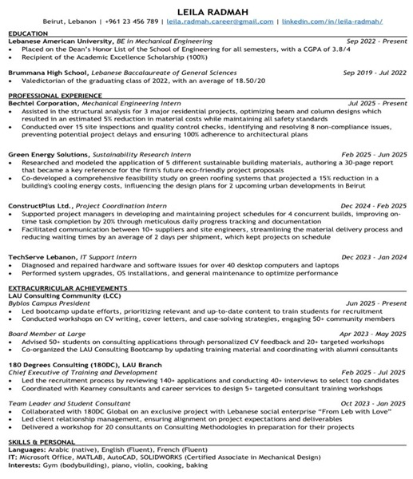
01 – Consulting Resume: One page of Judgment
The header exists only to identify you and allow the firm to contact you. Your name, phone number, professional email, location, and LinkedIn are sufficient. Photos, summaries, and personal branding statements are unnecessary.
Education matters most early in your career. List your degree, institution, and graduation year clearly. Include your GPA only if it strengthens your profile. Honors and a short list of relevant coursework can help, but only if they reinforce academic rigor. This section should be concise. Its role is to signal capability, not to explain your journey
Professional Experience: This the most important section of the resume. Consulting firms are not interested in what your job was supposed to be; they are interested in what you actually did and what changed because of it.
Each bullet should communicate one clear idea: an action you took, how you approached it, and the outcome. Numbers are powerful because they reduce ambiguity. Structure matters because it shows how you think.
Vague responsibilities, passive language, and generic verbs signal lack of ownership and are often enough to end the review.
Extracurricular achievements: Extracurricular Activities: Evidence of leadership, initiative, and sustained commitment beyond academics. Focus on roles where you drove outcomes, influenced others, or built something tangible—not passive memberships.
Skills and Interests: Small but Telling. Skills should be limited to what is relevant and credible. Languages, technical tools, and certifications can help if they are real and useful. Inflated skill lists hurt more than they help.
Interests are not filler. They are conversation starters and cultural signals. Specificity matters. Broad, generic interests signal low effort.

Slide 6
01 – Consulting Resume: Quick Tips
Writing Strong Points
Strong bullets start with action and end with impact. They are concise, specific, and structured. They avoid adjectives and focus on results. If a bullet cannot answer “So what?”, it does not belong on the resume
Consultants look for evidence of problem-solving, analysis, decision-making, and responsibility. Tools and methods only matter if they directly support these signals
Common Mistakes
Most resumes are rejected not because the candidate is weak, but because the resume is noisy.
Long paragraphs, inconsistent formatting, buzzwords without evidence, and spelling mistakes are all signs of poor judgment.
A consulting resume should feel calm, deliberate, and easy to read.

Slide 7
02 – Consulting Cover Letter: Introduction
The Cover Letter: A Short Business Case
Not all firms require cover letters, but when they do, the bar is high.
A cover letter is not a personal essay. It is a structured argument explaining why consulting makes sense for you, why you make sense for consulting, and why this firm in particular.
Anything outside of this logic weakens the message
Why Consulting?
Why You?
Why This Firm?

Slide 8
02 – Consulting Cover Letter: Components
Why Consulting?
The first paragraph should explain your interest in consulting in rational terms. Focus on problem-solving, exposure, learning, and impact. Avoid emotional language and long narratives
Why You?
The second paragraph connects your experience to consulting skills. This is where you demonstrate that you understand what the job requires and that you have already practiced those skills in different contexts
Why This Firm?
The final paragraph shows that you did your homework. Refer to the firm’s positioning, practice strengths, or culture in a specific way. Generic statements signal a generic application
A consulting cover letter should be one page, three short paragraphs, and easy to scan

Slide 9
Final Notes
Resume and Cover Letter do not get you the offer.
They earn you the right to interview.
What happens next depends entirely on preparation, practice, and performance.
No document will ever compensate for lack of practice, but the right document ensures you get the chance to prove yourself.

Slide 10
THANK YOU
| Consulting Headquarters (CHQ)
Instagram: consulting.hq | LinkedIn: Consulting HQ

